Slide 1
Internal Communications Overview:
Acquisition Model and Considerations
A tool from HFMA’s Value Project Toolkit: hfma.org/valueproject

Slide 2
Overview
Marketplace Characteristics/Drivers and Impacts
Organizational Strategic Goals
Organizational Strategic Initiatives
Affiliation/Acquisition Models
Process
Market, Community, and Organizational Considerations
Partner Evaluation Considerations
As Options Are Narrowed

Slide 3
Marketplace Characteristics/Drivers and Impacts (Examples)
Key national/regional trends (cost of care, revenue trends, patient mix trends and forecasts, etc.)
Major competitor actions/regional market dynamics
Organizational Impacts
Need for significantly improved cost structure through
Investment in supply chain and revenue cycle improvements
Investment in population health management infrastructure
Streamlined clinical care delivery; investment in clinically integrated networks
Patient and caregiver engagement
Need for excellent patient satisfaction scores
Given increased marketplace transparency and increased cost-sharing
Need for improved market share
Regional hospital consolidations represent more formidable competitors
Geographic expansion required; signficant capital investments

Slide 4
Organizational Strategic Goals (Examples)
Improve operating cost by $XX annually
Increase market share 3% annually
Improve select clinical quality metrics
Improve patient satisfaction scores
Improve employee engagement survey results
Etc

Slide 5
Organizational Strategic Initiatives (Examples)
Investment in revenue cycle improvement initiatives
Investment in electronic health record
Investment in other elements of population health infrastructure
Care delivery networks
Care coordinators
Disease registries
Etc.
Investment in geographic expansion
Care delivery process improvement initiatives
Etc.

Slide 6
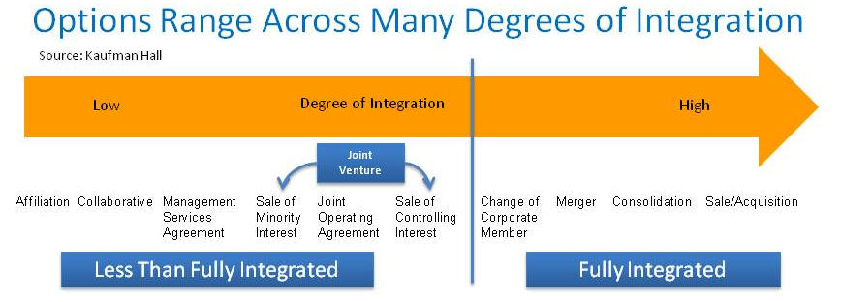
Affiliation/Acquisition Models
A wide and growing range of options and sub-options
Structure follows function (where do we need to go)
Models to the right are necessary for favorable access to capital
Less integrated models (to the left) retain more control at the community level and are more reversible
Either end of the continuum can be effective in gaining efficiencies and in accessing large enough populations to manage care effectively and assume risk

Slide 7
Affiliation/Acquisition Models
How do the potential models match up with our strategic objectives? For example:
Expand geographic footprint
Diversify operations
Invest in electronic health record and other elements of population health management infrastructure
Gain system-wide economies (such as supply chain or revenue cycle savings)
Gain regional economies (such as ensuring a logical mix of primary care physicians, specialists, other facilities and programs, etc.)

Slide 8
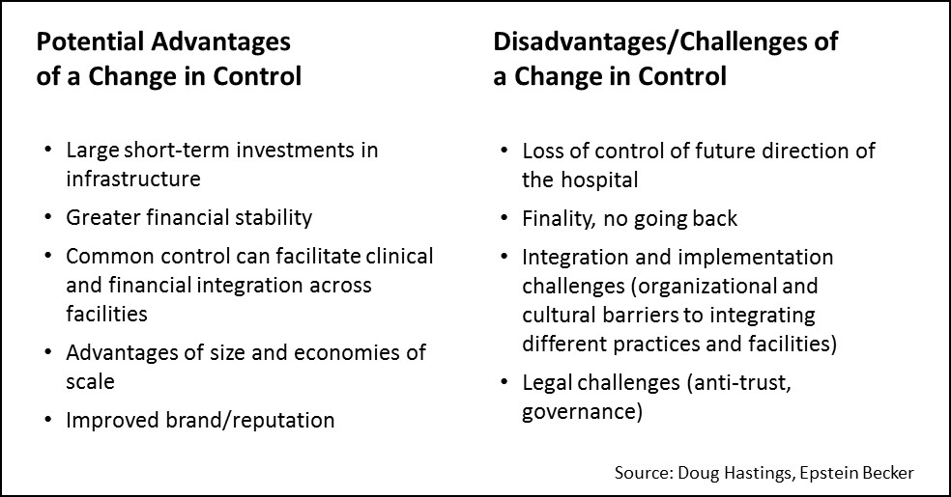
Acquisition/Affiliation Models
The key differences are between models that do or don’t require a change in control

Slide 9
Process
Describe what process has been utilized to examine acquisition options
Whether a consultant involved or not; how information is being gathered (including how internal impacts are being assessed)
Criteria to identify options, and winnow them down (e.g., type of model proposed; regulatory and image issues; internal impacts; financial impacts; relationship issues)
Timeline (and where the organization is currently in the process)

Slide 10
Market, Community and Organizational Considerations
What are our biggest needs or goals from acquisition?
What do we expect our competitors to do next?
What are our options for acquisition?
… in our region?
… outside of our region?

Slide 11
Market, Community and Organizational Considerations (continued)
What are the implications of our acquisition/affiliation options for
Our patients?
Our providers?
Our employees/staff? (Discuss impact on job stability and roles; employee benefits)
Our employers and other key stakeholders?

Slide 12
Partner Evaluation Considerations
The type of acquisition model proposed (e.g., sole substitution; full acquisition; 75%/25% joint venture, etc.)
Details of financial proposals
Regulatory and image issues
Ability of partners to deliver on our strategic initiatives
Relationship issues

Slide 13
As Options Are Narrowed …
Perform Due Diligence (legal, financial, regulatory and compliance)
Conduct Business Planning
Vision
Approach/Organizational Structure
Capitalization
Governance (powers, roles and responsibilities, etc.)
Management Structure and Initial Management
Early Initiatives and Priorities
Financial Projections
Execute Definitive Agreement (standard and negotiated terms)

