Slide 1
HFMA CERTIFICATIONS
Notes:
Good afternoon!
Today we are going to talk about HFMA Certifications!

Slide 2
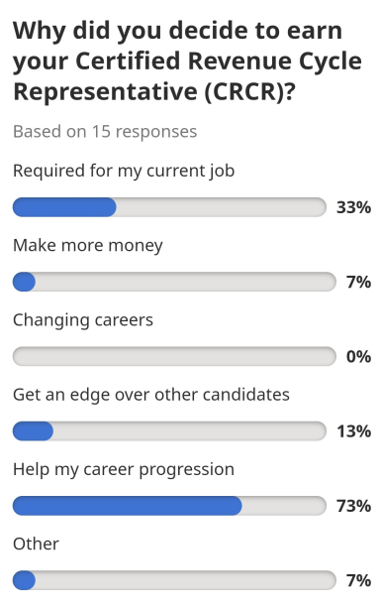

Certified Revenue Cycle Representative
Why Become Certified?
Source: https://www.indeed.com/certifications/view/certified-revenue-cycle-representative-crcr-G45HGKZR
Notes:
Start with Why Become Certified.
Job Search:
Review Indeed.com
Survey with a small sampling
Helps my career progression
Required for my current job.
As the certification chair, I was excited!
3. Job Postings:
Executive VP Client Success;
Under employment qualification ~ CRCR
Revenue Cycle Reimbursement Specialist,
Section called “about you” ~ Certified Revenue Cycle Representative
Revenue Integrity Analyst
Under Required Licenses/Certifications ~ CRCR-Preferred
Employers across the nation have recognized the CRCR as a value-added certification.
They require it at jobs and starting to require it to hired for a job.
Employees see the value of the CRCR and believe it can help with the progression of their career.

Slide 3
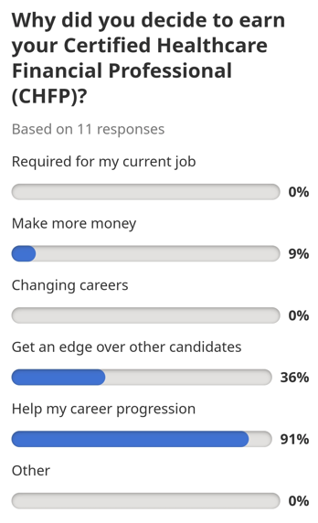

Certified Healthcare Financial Professional
Why Become Certified?
Source: https://www.indeed.com/certifications/view/certified-healthcare-financial-professional-chfp-7HZ7O7YZ
Notes:
Review Indeed.com
Survey with a small sampling
Helps my career progression-91%
Get an edge over other candidates
Some of you in the room are at the top of your career, but others are not.
If you are just getting started or somewhere in the middle,
How do you advance your career?
If you are at the top, most of you are driven.
How do you keep your knowledge fresh?
How do you keep reaching for the top?
The different HFMA certifications are tools available to you as HFMA members to use in your career growth plan or to stay fresh and at the top.

Slide 4
HFMA CERTIFICATIONS
Certification Course | Certified Healthcare Financial Professional | Certified Revenue Cycle Representative | Certified Specialist Accounting And Finance | Certified Specialist Business Intelligence | Certified Specialist Payment & Reimbursement | Certified Specialist Physician Practice Management
Prerequisite | None | 1+ Yr Exp in Revenue Cycle | None | None | 1-2 Yrs Exp in Payment, Reimbursement or Managed Care Setting. | 1-2 Yrs Exp in Physician Practice Setting
Modules | I & II
Program Includes | Key concepts guide, course modules, and certification assessments for Module I and Module II | Key concepts guide, course modules, and a certification assessment | Course modules and a certification assessment | Course modules and a certification assessment | Course modules and a certification assessment | Course modules and a certification assessment
Assessment | Module I: 75 multiple-choice questions, and you have 90 minutes to complete it in one sitting. Module II: 8 case studies you have 3 hours to complete it in one sitting. | 75 multiple-choice questions and 90 minutes to complete it in one sitting | 75 multiple-choice questions and 90 minutes to complete it in one sitting | 75 multiple-choice questions and 90 minutes to complete it in one sitting | 75 multiple-choice questions and 90 minutes to complete it in one sitting | 75 multiple-choice questions and 90 minutes to complete it in one sitting
Total Time | Module I- 14-20 Hours Module II- 3 hours (exam) | 10-14 Hours | 12-14 Hours | 10 Hours | 10-13 Hours
Notes:
This slide lists all certification opportunities.
Quickly go through each one.

Slide 5
HFMA CERTIFICATIONS
Each Exam:
Available online, 24/7
Included in HFMA membership
The passing score is 70%.
If you do not pass on the first attempt, there is a mandatory 30-day waiting period.
Notes:
These apply to each exam.
We have talked about this before. **What are the factors that would prevent you from taking one of the certifications?**
1. Time-yes very valid, but I showed you the average time it takes to take the exam.
CHFP-for me. I studied for it while waiting for my daughter to take her lifeguard certification course.
CRCR-one weekend at home split into a couple of days.
CSAF-broken out over a week in the evenings.
Rather than shopping, watching TV, reading a book, I studied for a short period.
2. FEAR- We all want to pass, but if we don’t, what happens? You wait 30 days and try again. No one will know.
I know of a few because they laughed at themselves or they wanted to understand how to move forward. If you don’t tell anyone, no one will know.

Slide 6
FELLOW OF HFMA
Requirements for FHFMA® certification include:
Hold the Certified Healthcare Financial Professional (CHFP) designation
Minimum five (5) years professional membership in HFMA (student membership does not count toward this total)
Evidence of bachelor's or master’s degree
Letter of recommendation from:
  An FHFMA (active HFMA Fellow) (familiar with you/your work on a professional level),
  Chapter leader (familiar with you/your work on a professional level) or
  National volunteer (familiar with you/your work on a professional level)
Volunteer activity — see next slide
Note: Fellow candidates must meet all the requirements prior to applying.
Notes:
Get your mental checklist ready. All you need is:
Ask attendees to stand if they are a Fellow to stand. Congratulations and thank you for your volunteer service to HFMA.
List how many we have in the chapter that are fellows.
Ask those who are CHFP but not Fellows to stand.
There is one more step above the CHFP for career progression. Becoming a fellow.

Slide 7
FELLOW OF HFMA
Volunteer activity — demonstrate any one, or combination of the following contributions to HFMA or the industry within the three years prior to applying:
  Service as an adjunct instructor at an accredited (post-secondary school) educational institution.
  Service in an education, certification, or leadership committee role within the local HFMA chapter or service on one of the HFMA association boards or committees.
  Demonstrating a minimum of 10 Hours in the service or preparation of one of the following:
    Preparation and publication of professional articles in a publication accepted as authoritative in the healthcare industry.
    Speaking to community groups on health care issues
    Providing internal staff education on healthcare finance topics
    Presenting at an HFMA educational program
    Presenting at a related healthcare industry educational program
    Assistance to those desiring HFMA certification or fellowship designation
    Mentorship of healthcare finance professionals
Note: Fellow candidates must meet all the requirements prior to applying.
Notes:
The part I want you to focus on in this slide is the service in an education, certification, or leadership committee role with the local HFMA chapter.
This is a great opportunity to volunteer for the IA Chapter.
If you are interested in volunteering, seek out Deanna Gray and she can help you find the right opportunity for you.
Also, for those who have committed endless hours to volunteering for the chapter, most likely the only thing standing between you and being a Fellow…is passing the exam. ☺

Slide 8
Maintenance
Maintain Membership (CHFP/Fellow)
Complete 60 hours of eligible education (3yrs) (CHFP/Fellow)
Eligible education must include 20 hrs of HFMA, regional or chapter education.
Education Activity: Group internet/live programs, self study, presenter, publication
Use online reporting tool
CRCR – Take a 50-question online assessment every two years
Certified Specialist programs – Take a 50-question online assessment every two years
HFMA sends notifications 6 months in advance
Once all activities are complete, HFMA website will move to the next cycle
Notes:
Go through each section.
At the end:
Now we talked about why
We talked about what’s available.
We talked about what is stopping you
Now let’s take a look at those who have did it.

Slide 9
21/22-CERTIFIED
Angela Knox, CRCR
Brianna Klein, CRCR
Jessica Hoepker, CRCR
Katie Ehrman, CRCR
Laurie O’Connor, CRCR
Tonia LaShelle, CRCR
Jamie Hossle, CHFP* (20/21 CRCR)
Eric Brodahl, CSAF
Paula Davey, CSBI
Notes:
If you are here and I read your name, please stand up!

Slide 10

CHALLENGE

Slide 11
Questions?
Amber Tronchetti
Xander Younce
Andy Bernhard
Bradley Jessen
Shelly Giddings
Katie Hanten
Jamie Hossle
Julianne Kipple
Barbara Kingery
Gail Loschen
Vicky Marker
Certification Committee:melaScott
Hilary Christiansen~ hilary.christiansen@EssentiaHealth.org
Bryant Blay ~ brybla@mcmh.org
John Schwarm ~ John.Schwarm@cbecompanies.com
Amy Benton
Charlie Hammel
Julie Anstey

